Slide 1
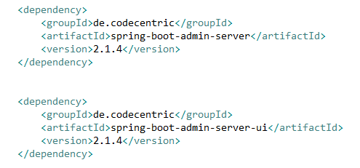
Spring Boot - Admin Server
Monitoring your application by using Spring Boot Actuator Endpoint is slightly difficult. Because, if you have ‘n’ number of applications, every application has separate actuator endpoints, thus making monitoring difficult. Spring Boot Admin Server is an application used to manage and monitor your Microservice application.
To handle such situations, CodeCentric Team provides a Spring Boot Admin UI to manage and monitor all your Spring Boot application Actuator endpoints at one place.
Change the spring version
And try check next example

Slide 2
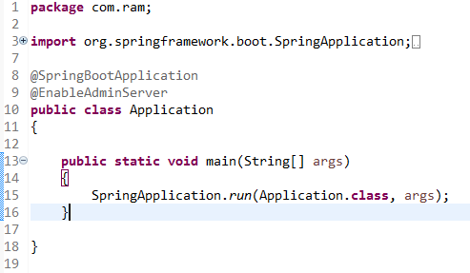

Spring Boot - Admin Server
Add the @EnableAdminServer annotation in your main Spring Boot application class file. The @EnableAdminServer annotation is used to make your as Admin Server to monitor all other microservices.

